Slide 1

Heredity and Evolution
An Illustration Of Evolution - Situation 1

Slide 2
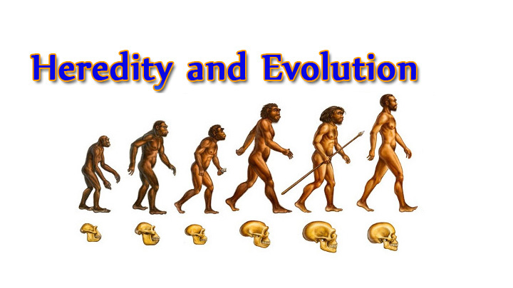

Slide 3


There is an inbuilt tendency of variation during reproduction, both because of errors in DNA copying, and as a result of sexual reproduction.

Slide 4


These variations leads to evolution

Slide 5

Let’s understand evolution with an illustration

Slide 6

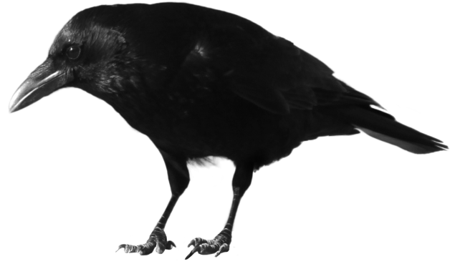
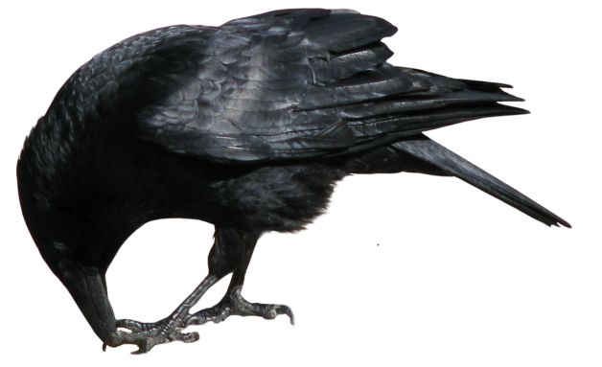

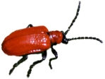
An illustration of evolution
Let us imagine
that crows eat these beetles.
The more beetles the crows eat, the fewer
beetles are available to reproduce.
Their population will grow by sexual reproduction
Let us assume there is a group of red beetles living in bushes with green leaves
Let us think about two different situations that can develop in this beetles population

Slide 7


An illustration of evolution
Situation 1
Their population will grow by sexual
reproduction, and therefore, can generate variations.
A colour variation arises during reproduction,
so that there is one beetle that is green in colour instead of red.
Red and green beetles
Reproduce and pass the green colour to its offspring.

Slide 8
An illustration of evolution
Situation 1
But the red beetles continues to be eaten by crows as crows can see only the red beetles.
Crows cannot see green-coloured beetles on the green leaves of the bushes, and therefore cannot eat them.
As a result, there are more
and more green beetles than red ones in the beetle population.
From situation 1, we can observe that, what started out as a rare variation came to be a common characteristic in the population.
Now, Let’s discuss the second situation

Slide 9
Thank You

